Slide 1



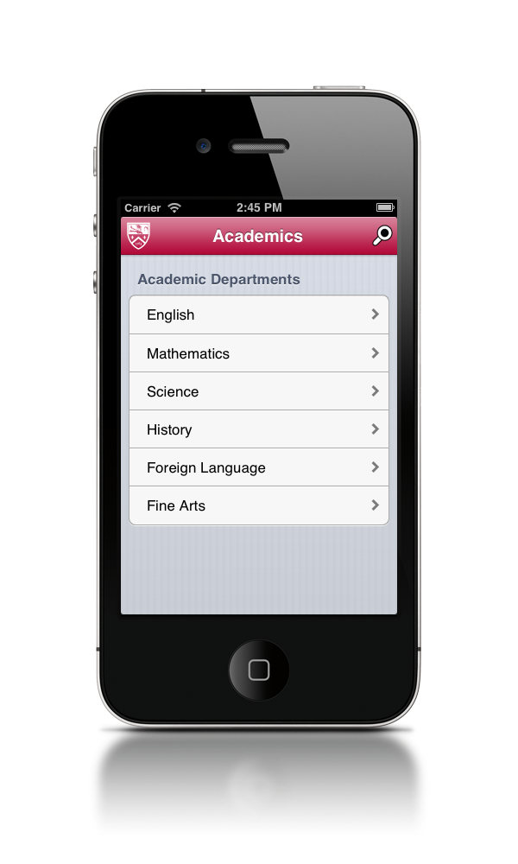

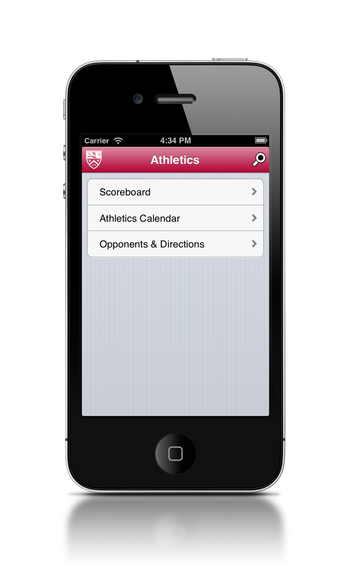
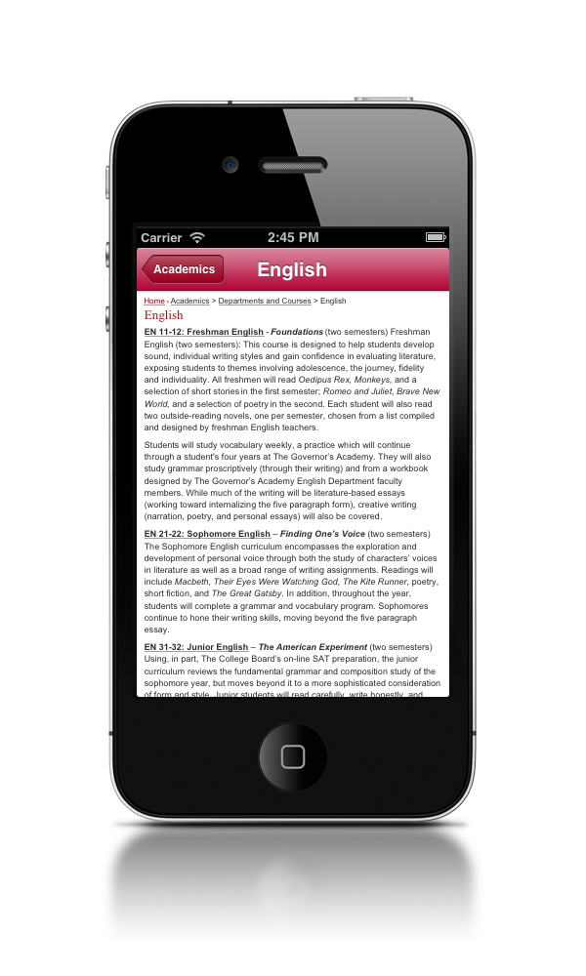
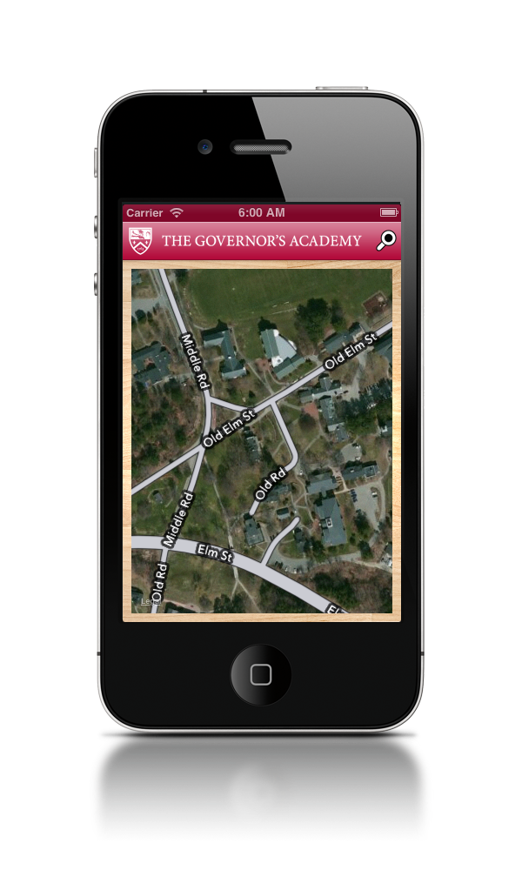
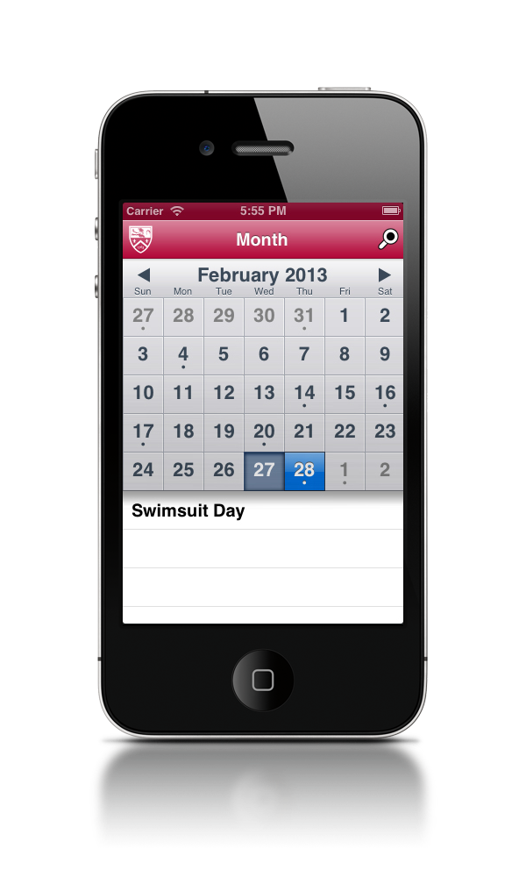


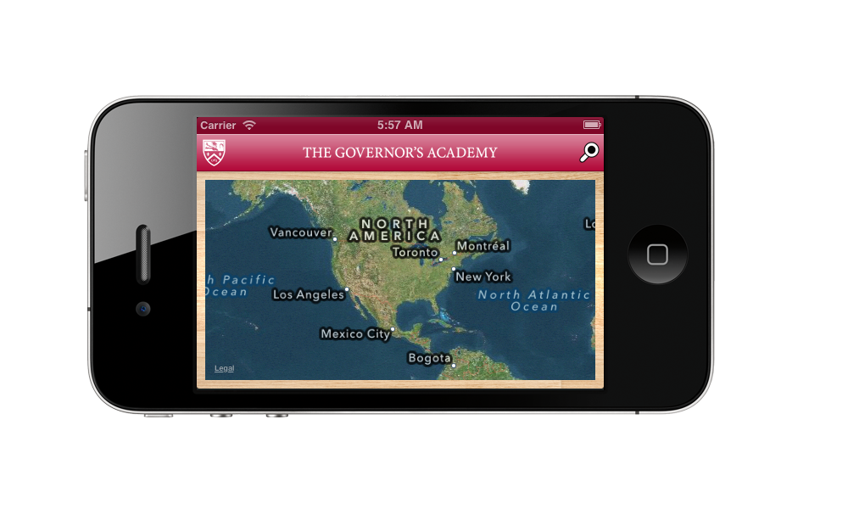
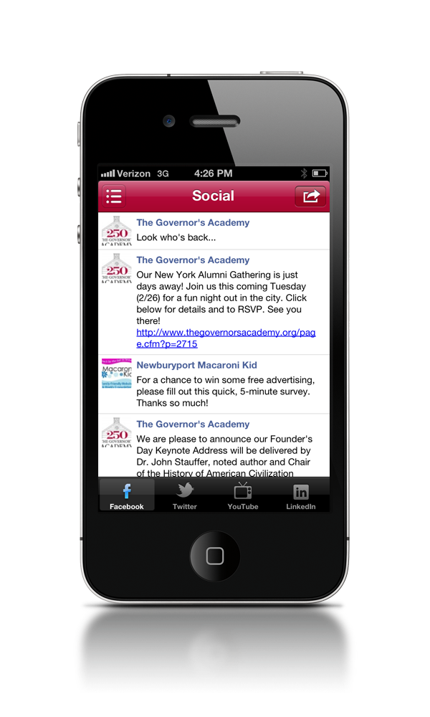
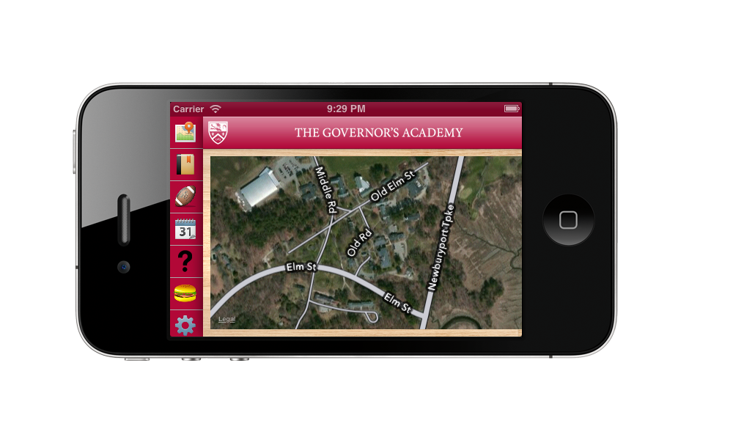
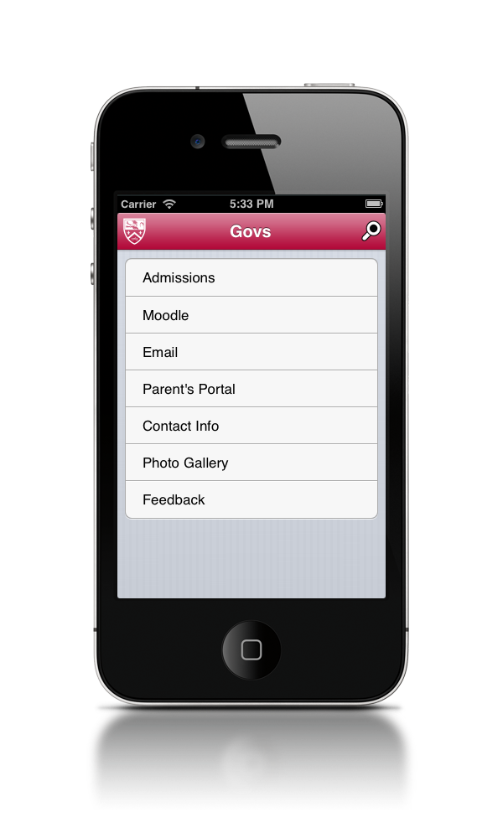


MILESTONE APP
By the Productions Club
Academics
Athletics
The Academics Page will feature information about an individual’s classes, grades and assignments. Users will be able to find general and course information about each department.
The Athletics page links the user to the scores of current and past matches, the athletic calendar and weekly practice schedules. In addition, families can find directions to away games.
Calendar
Maps
In Maps, the user will be able to locate themselves on campus, their friends if they choose, and the surrounding buildings. In addition users can “check into” events and view “checked-in users.”
The Calendar page allows the user to view the months through a grid Information about weekly events can be found on the “Week” page. Similarly, daily events are found on the “Today” page.
Overview info
Home Screen
Social
Govs Life
Productions info
http://supercolortuts.com/retro-rainbow-stripes-wallpaper/

